Slide 1



Name of Project
Electric Vehicle Demand Prediction Using Machine Learning

Slide 2
CONTENT
Learning Objectives
Tools and Technology used
Methodology
Problem Statement
Solution
Screenshot of Output
Conclusion

Slide 3

Learning Objectives
Analyze historical EV registration data across counties.
Identify trends and seasonality in EV adoption.
Train and evaluate time-series models to forecast EV
demand.
Use lag features and growth metrics to improve accuracy.
Support policy and infrastructure planning with predictions.
GOAL
Source :
www.freepik.com/

Slide 4
Tools and Technology used
Python, Pandas, Scikit-learn, Matplotlib
Time-series preprocessing with rolling/lags
Machine Learning: Random Forest Regressor
Libraries: NumPy, Seaborn
Model Format: .pkl (joblib-saved)

Slide 5
Methodology
1. Data Cleaning: Used cleaned dataset of 12,573 entries across counties.
2. Feature Engineering: Added lag variables, percent changes, rolling averages.
3. Model Training: Trained Random Forest Regressor on preprocessed features.
4. Forecasting: Used .pkl model to predict monthly EV growth.
5. Evaluation: Compared predictions to historical trends.

Slide 6
Problem Statement:
The rise in environmental concerns and policy support has driven EV adoption. However, accurate demand forecasting remains a challenge due to volatile market trends.
Electric vehicle adoption is growing but varies by location and time. Stakeholders need accurate demand forecasting for effective infrastructure, production, and policy planning.
The project aims to build a model that predicts EV demand to aid strategic decisions.

Slide 7
Solution:
A trained forecasting model using temporal and county-based features.
Predicts EV totals by month using engineered lag and growth metrics.
Output supports local policy, utility load forecasting, and urban planning.

Slide 8
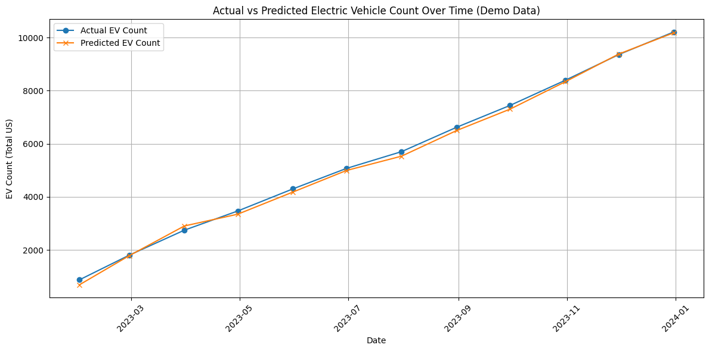
Screenshot of Output:

Slide 9
Conclusion:
The model captured EV demand trends at a granular level.
Time-based features like lags and growth rates improved accuracy.
The tool helps in understanding long-term EV growth for planning.
Useful for automakers, energy providers, and city planners

Slide 10
THANK YOU

